Slide 1
Old Main Classroom Equipment

Slide 2
Wall Panels
Turn projector display ON or OFF
Switch to this input, when viewing a document
Adjust the volume here. PC volume should be set to its maximum potential. If it is still quiet, check the volume in the program that you are running.
If you BYOD you can use these inputs. One is HDMI. Two is VGA and audio (separate)
You can mute the audio here.

Slide 3
Document Camera
Push this button to auto focus on the document

Slide 4
Document Camera
Turn the knob to enable the zoom function.

Slide 5
Document Camera
Power on/off for the document camera here. A blue light means the document camera is on.
The input should always be on the document camera so that it displays the image.
Adjust the brightness of the document by using the left button to increase brightness and the right button to decrease it

Slide 6
Front Panel
No end user modifications can be made through the switching unit. The wall plate controls everything
If there is no power to the PC or monitor, make sure the switch is turned on (lit).

Slide 7
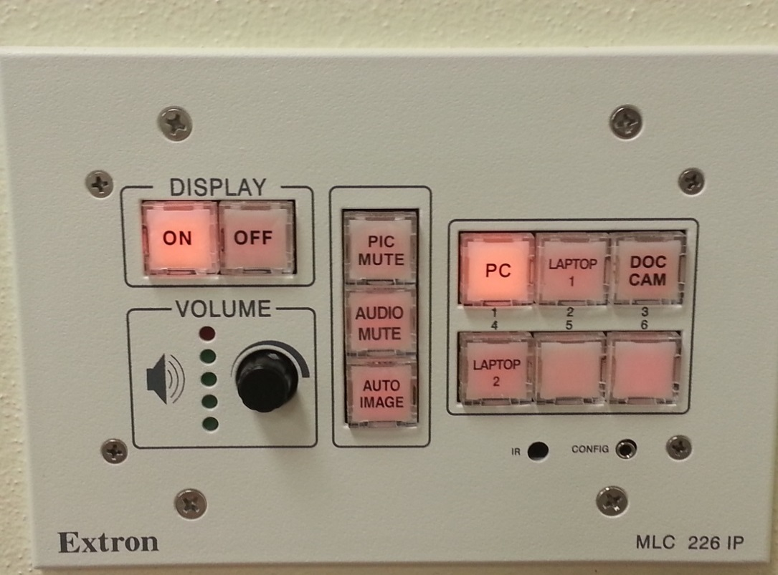
Laptop 1 Input
If you BYOD you can project your display using the HDMI cord labeled Laptop 1.
Make sure input is then set to Laptop 1

Slide 8
Laptop 2 Input
If you BYOD you can also project your display using the VGA and audio cable labeled Laptop 2.
Make sure input is then set to Laptop 2

